Slide 1
9th Class
Political Science
Chapter -2
What is Democracy ? Why Democracy ?

Slide 2
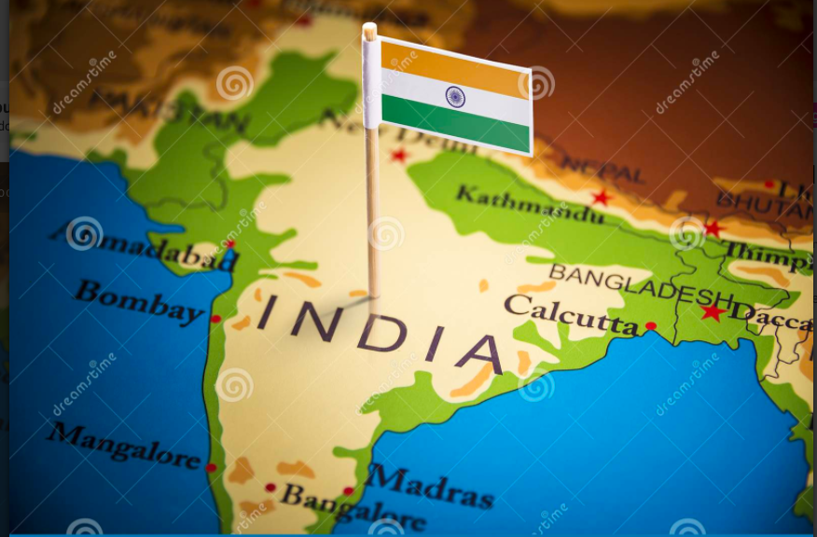
India is considered as the largest democratic nation in the world

Slide 3
ABRAHAM LINCOLN
Democracy is the government of the people by the people
For the people .

Slide 4
Democracy comes from a Greek word DEMOKRATIA
DEMO MEANS PEOPLE
KRATIA MEANS RULE
Which means rule by people

Slide 5
Point to be remember the meaning of world changes with the time
For example computer use for calculations earlier but now use for several purposes so the word remains the same but meaning changes with time

Slide 6
DEMOCRACY
Democracy is a government where people are elected by the people
but there are other forms of government which are not democratic !
Examples : Monarchy in Saudi Arabia and Nepal

Slide 7
The Features of Democracy
1-Major decisions aretaken by the elected leaders.
2-Fair opportunity to people. And power to change the rulers.
3-One person,one vote , one value .
4-Rule of law and respect for rights.

Slide 8
Major decisions by elected leaders
In Pakistan General Parvez Musharraf led a military coup in October 1999 .He overthrew a democratically elected government and declared himself the’ Chief Executive’ of country .Later he changed his designation to President and in 2002 held a referendum in the country that granted him a five year extension .Pakistani media human rights organization and democracy activists said that the referendum was based on malpractices and fraud .In 2002
President dismissed the national and provincial assemblies.

Slide 9
Free and fair electoral competition
In China elections areregularly held afterbevery five years people have power for electing the country’s parliament
National people congress have power to oppoint President but before
Contesting elections a candidate needs the approval of the Chinese
Communist Party.
So Elections are there but Fair opportunity is not there .

Slide 10
One Person One Vote One Value
Until 2015 , in Saudi Arabia women did not have the right to vote .
Estonia has made its citizenship rules in such a way that people belonging to Russian minority find it difficult to get the right to vote.
In Fiji the electoral system is such that the vote of an indigenous
Fiji has more value than that of an Indian -Fijian .

Slide 11
Rule of law and Respect for rights
ZANU-PF the party that led the freedom struggle its leader Robert Mugabe ruled the country since Independence.
but he also uses unfair practices in elections.
Changing the constitution several time to incease his power.
Harassing the workers of opposition parties.
Disrupting their meetings .
Law that limits the right to criticize the President.
Media is controlled by the ruling party .
Pressurizing the judge and ignoring court judgements that went against the government.
To conclude popular leaders can be Undemocratic.

Slide 12
Merits
Demerits
It provides a METHOD to DEAL with difference and conflicts
Allow us to CORRECT its own MISTAKE
Improves the quality of DECISION MAKING
Enhance the DIGNITY of its CITIZENS
More ACCOUNTABLE from of government
Leaders keep changing leading to INSTABILITY
Its ALL ABOUT competition power and corruption
Consultance SO MANY PEOPLE leads in decision
LEADERS DONT KNOW best of people thus leading to bad decision
Ordinary PEOPLE DON’T KNOW who is good for them

